Slide 1

A wind tunnel for kids…

Slide 2
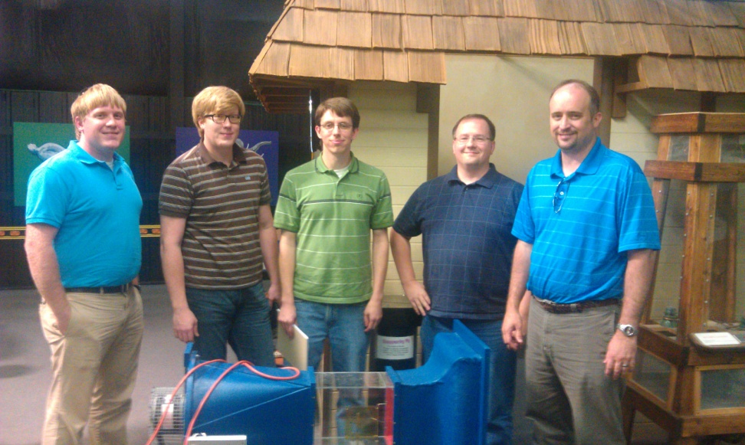
Project Team
Michael Lynch, Wes Cothran, Brian Pittman, Josh Calahan, Chris Davis (from left to right)
All team members are AEDC employees

Slide 3
Project Overview
Deliver a small-scale wind tunnel exhibit and associated software systems for use in science centers and classrooms
In association with the Hands-On Science Center in Tullahoma, TN
Primary POC is Sean Smith, Vice-President of the HOSC Board of Directors

Slide 4
Project Status
Team met several times at AEDC to discuss project and develop ideas
Met with Sean Smith and Misty Marshall (Director, HOSC) at the center to discuss project
Center has offered up an existing wind tunnel (and workspace, if needed!)
Fabrication is NOT finished: sensors, model mount, actuators, buttons, etc. needed

Slide 5
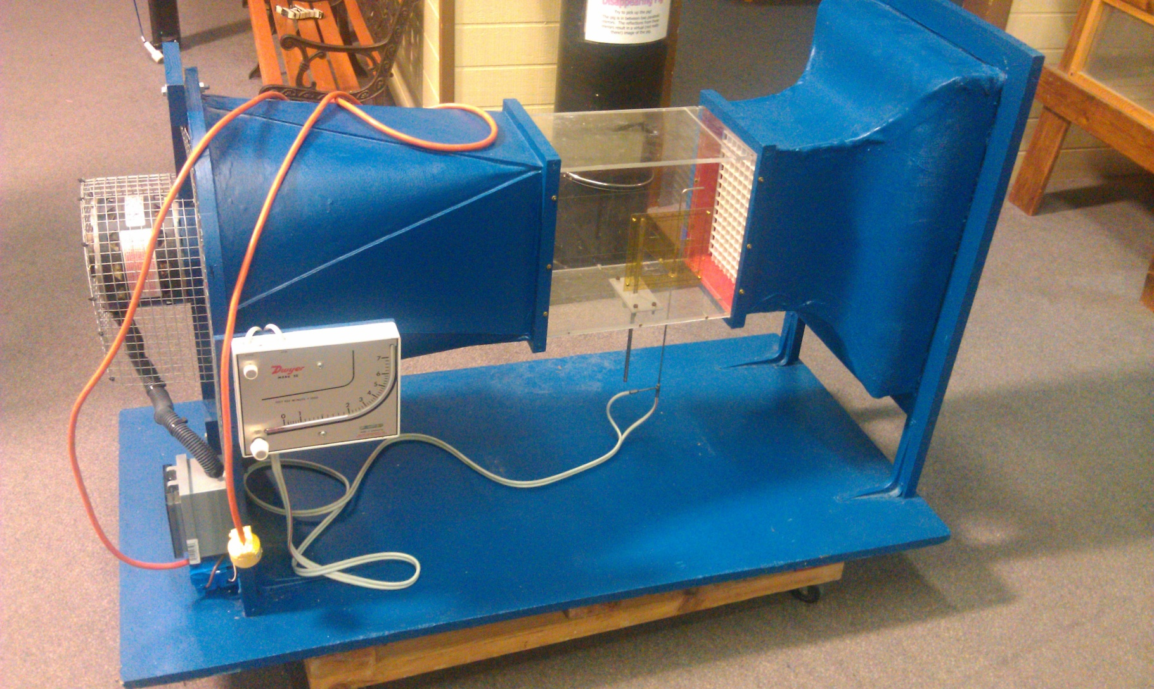
Project Status

Slide 6
Project Status
Created shared workspace which can also be accessed by stakeholders to monitor progress
http://code.google.com/p/tunnelk
Offers version control (git), wiki, discussion group, etc.

Slide 7
Draft Requirements
Project shall:
provide software for automated control and monitoring of the tunnel fans, actuators, and sensors
provide GUI for interacting with the tunnel as well as for general monitoring
provide “auxiliary” system(s) to augment the functionality of the exhibit

Slide 8
Potential Auxiliary Systems
2D Flow Simulation
2D Flow Visualization
6 DOF Model Positioning
Tunnel Flow Visualization
(Dry ice, humidifier, laser sheet, etc.)
Sweep or Rake For Flow Field Measurements
Variable Speed Fan Motor
Webcam/Social Network Integration

Slide 9
Draft Non-Functional Requirements
Project shall:
provide durable child proof physical controls – the tunnel will be a museum exhibit and will be operated by children
provide highly reliable and intuitive software interfaces, suitable for children
provide autonomous startup, shutdown, and reset
remain open in nature, utilizing open source hardware and software wherever sensible/possible
Minimize cost, remove barriers to replication

